Slide 1
Computational Foundations for ML (10-607):
Continuous optimization
Bryan Wilder
* Slides borrowed from prior offerings by Professors H. Heidari, M. Gormley, P. Virtue, & G. Gordon.

Slide 2
Announcements
Final quiz: Friday during recitation period
Covers material since quiz 2 through today (i.e., does not include Wed)
Trees: various tree traversals, binary search trees
Stacks, queues, and heaps: operations and implementations
Graphs: data structures, BFS/DFS, Kruskal’s and Dijkstra’s algorithms
Today: gradient descent algorithms

Slide 3
Today
Last week of the class is devoted to optimization
Seen various examples so far: shortest paths, knapsack problems, minimum spanning trees…
This week, two broad families of approaches:
Gradient descent algorithms for continuous optimization
Search and discrete optimization

Slide 4
Continuous optimization
So far, we’ve dealt primarily with discrete optimization
What do we mean by discrete? Solutions can take only one of a finite set of values
An item is in the knapsack or not, an edge is in the MST or not, etc.
Most common optimization problem in ML is over the parameters of a model: often continuous
Coefficients of a linear or logistic regression model
Parameters of a neural network

Slide 5
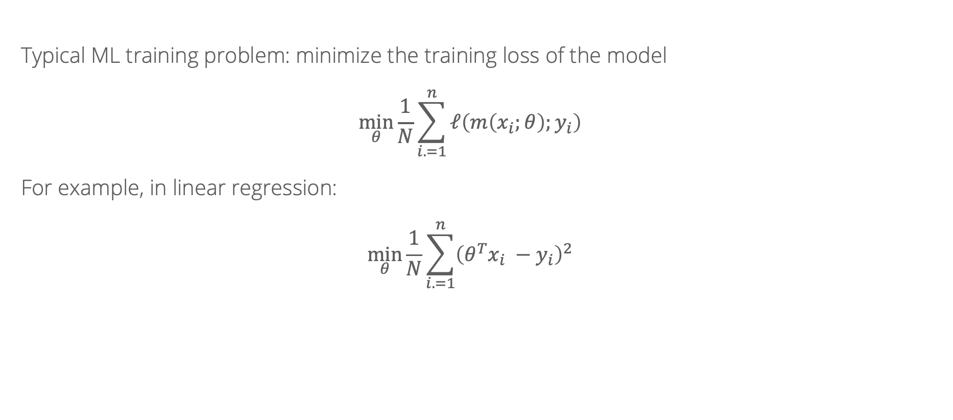
Empirical risk minimization
Typical ML training problem: minimize the training loss of the model
$$\min_{θ}{\frac{1}{N}\sum_{i. =1}^{n}{ℓ\left(m\left(x_{i};θ\right);y_{i}\right)}}$$
For example, in linear regression:
$$\min_{θ}{\frac{1}{N}\sum_{i. =1}^{n}{{\left({θ^{T}x}_{i} −y_{i}\right)}^{2}}}$$

Slide 6
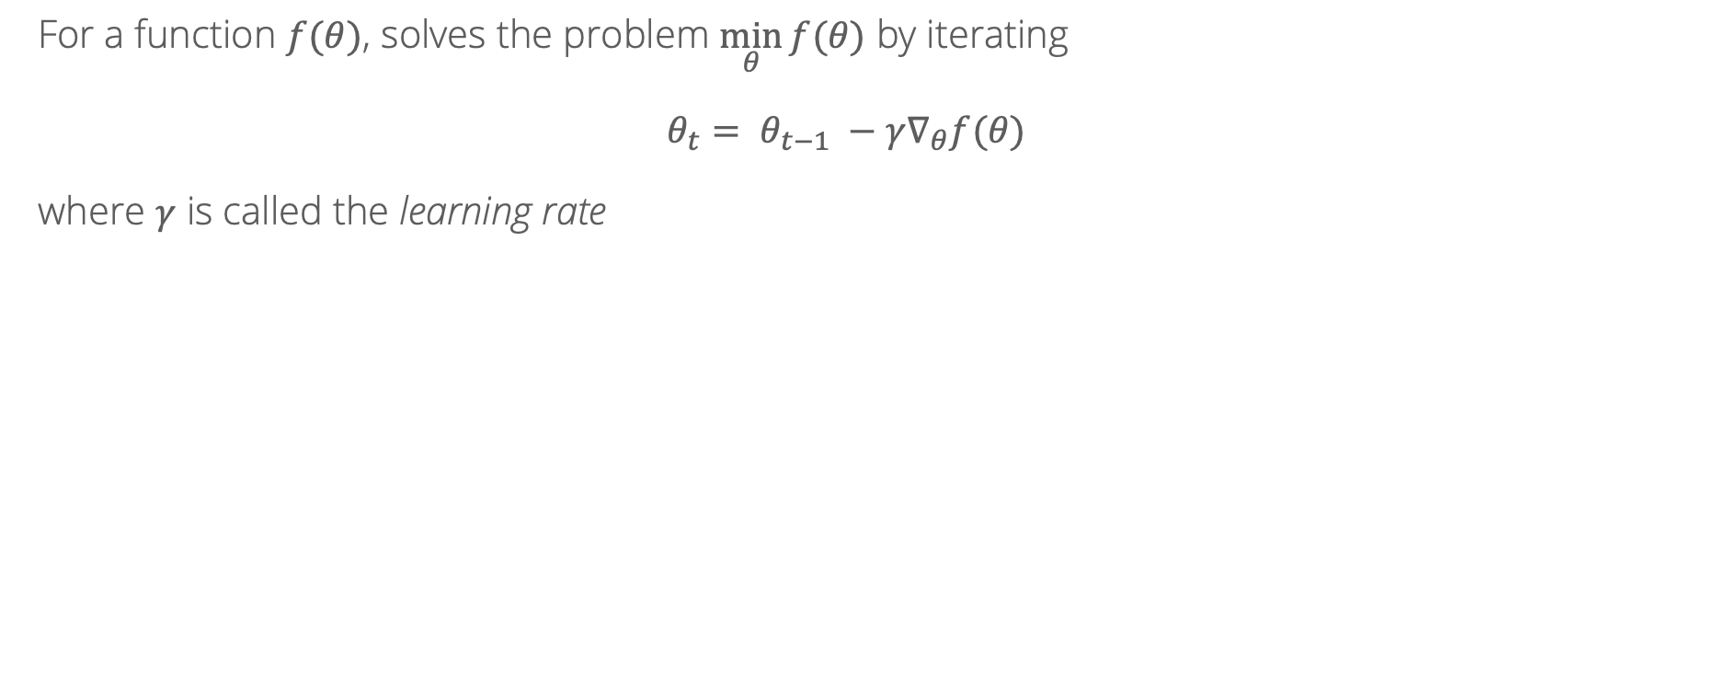
Gradient descent: review
For a function $f(θ)$, solves the problem $\min_{θ}{f(θ)}$ by iterating
$$θ_{t}= θ_{t−1} −γ∇_{θ}f(θ)$$
where $γ$ is called the learning rate

Slide 7
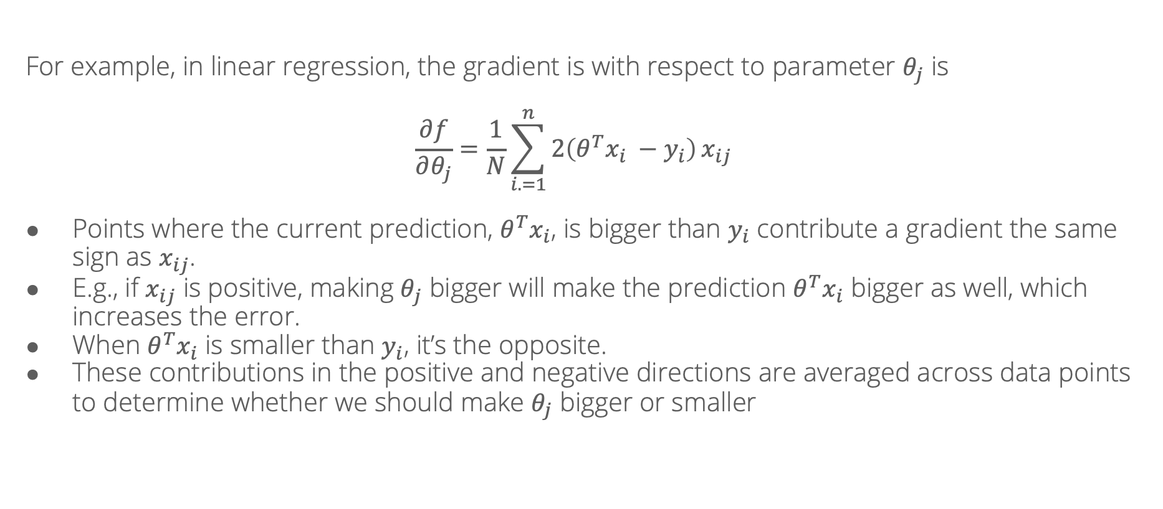
Gradient descent: review
For example, in linear regression, the gradient is with respect to parameter $θ_{j}$ is
$$\frac{∂f}{∂θ_{j}}=\frac{1}{N}\sum_{i. =1}^{n}{2\left({θ^{T}x}_{i} −y_{i}\right)}x_{ij}$$
Points where the current prediction, ${θ^{T}x}_{i}$, is bigger than $y_{i}$ contribute a gradient the same sign as $x_{ij}$.
E.g., if $x_{ij}$ is positive, making $θ_{j}$ bigger will make the prediction ${θ^{T}x}_{i}$ bigger as well, which increases the error.
When ${θ^{T}x}_{i}$ is smaller than $y_{i}$, it’s the opposite.
These contributions in the positive and negative directions are averaged across data points to determine whether we should make $θ_{j}$ bigger or smaller

Slide 8
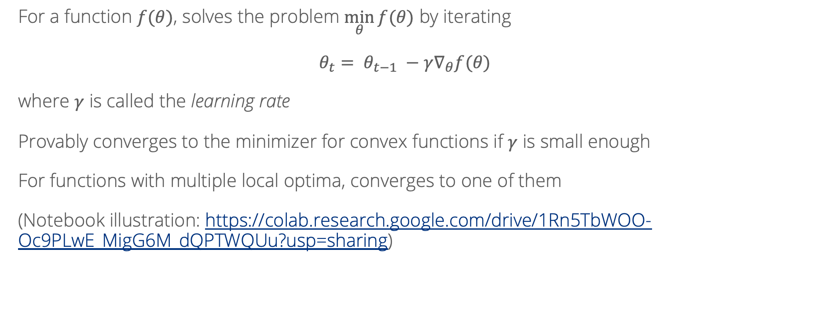
Gradient descent: review
For a function $f(θ)$, solves the problem $\min_{θ}{f(θ)}$ by iterating
$$θ_{t}= θ_{t−1} −γ∇_{θ}f(θ)$$
where $γ$ is called the learning rate
Provably converges to the minimizer for convex functions if $γ$ is small enough
For functions with multiple local optima, converges to one of them
(Notebook illustration: https://colab.research.google.com/drive/1Rn5TbWOO-Oc9PLwE_MigG6M_dQPTWQUu?usp=sharing)

Slide 9
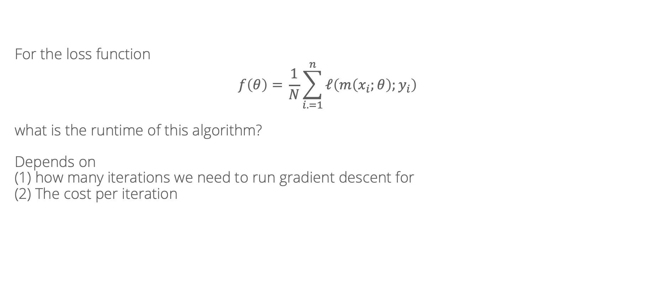
Algorithmic properties of gradient descent
For the loss function
$$f\left(θ\right)={\frac{1}{N}\sum_{i. =1}^{n}{ℓ\left(m\left(x_{i};θ\right);y_{i}\right)}}$$
what is the runtime of this algorithm?
Depends on
(1) how many iterations we need to run gradient descent for
(2) The cost per iteration

Slide 10
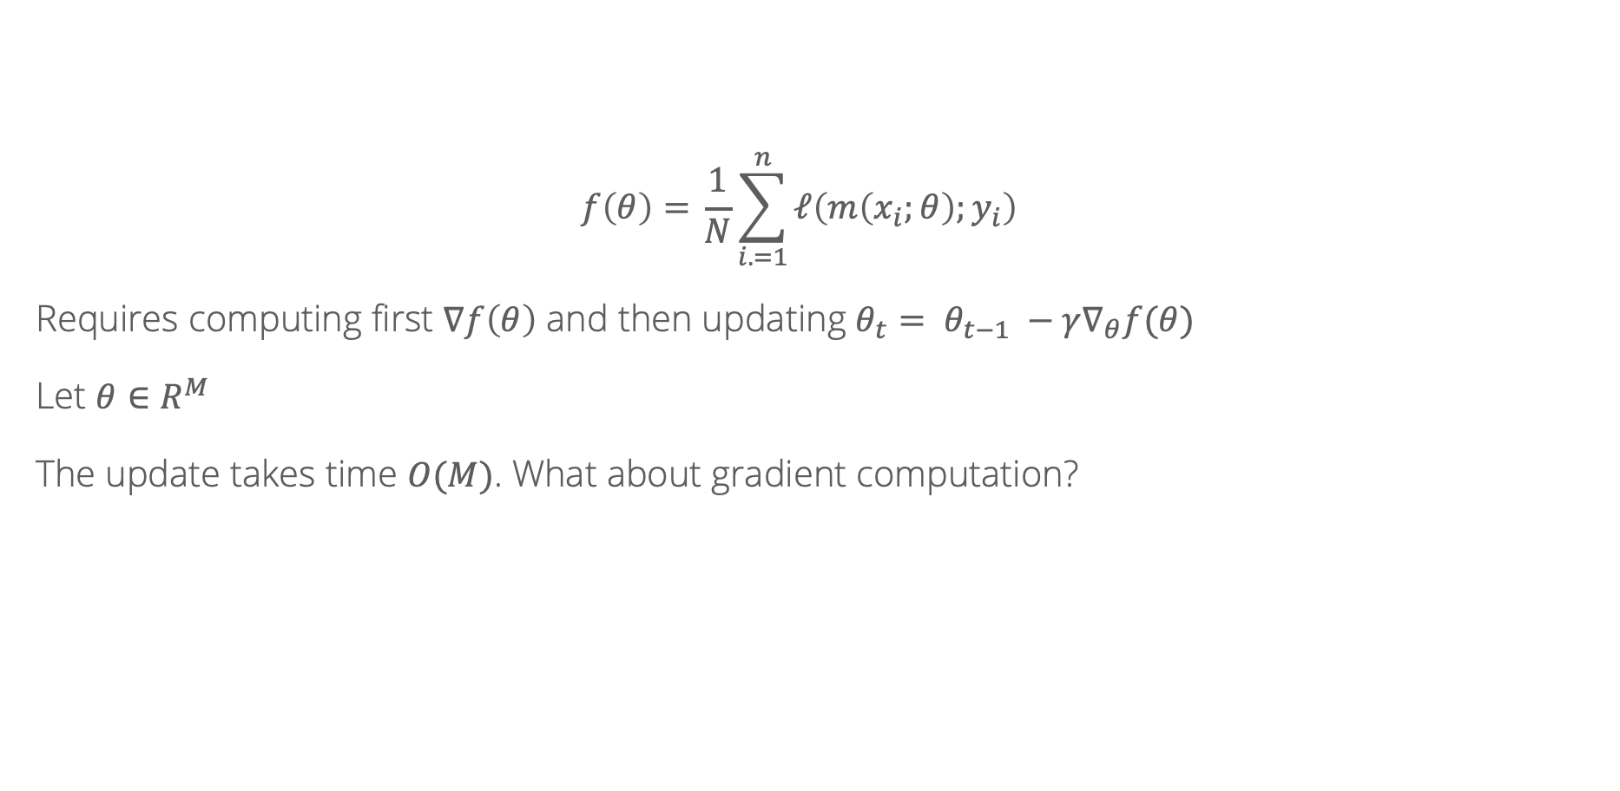
Cost per iteration
$$f\left(θ\right)={\frac{1}{N}\sum_{i. =1}^{n}{ℓ\left(m\left(x_{i};θ\right);y_{i}\right)}}$$
Requires computing first $∇f\left(θ\right)$ and then updating $θ_{t}= θ_{t−1} −γ∇_{θ}f(θ)$
Let $θ∈R^{M}$
The update takes time $O(M)$. What about gradient computation?

Slide 11
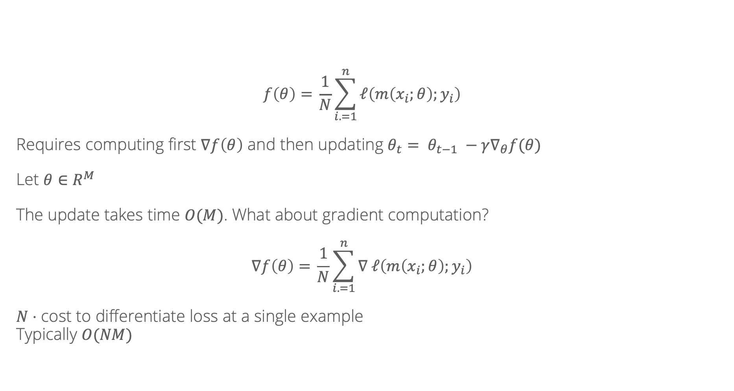
Cost per iteration
$$f\left(θ\right)={\frac{1}{N}\sum_{i. =1}^{n}{ℓ\left(m\left(x_{i};θ\right);y_{i}\right)}}$$
Requires computing first $∇f\left(θ\right)$ and then updating $θ_{t}= θ_{t−1} −γ∇_{θ}f(θ)$
Let $θ∈R^{M}$
The update takes time $O(M)$. What about gradient computation?
$$∇f\left(θ\right)={\frac{1}{N}\sum_{i. =1}^{n}{∇ ℓ\left(m\left(x_{i};θ\right);y_{i}\right)}}$$
$N⋅$ cost to differentiate loss at a single example
Typically $O(NM)$

Slide 12
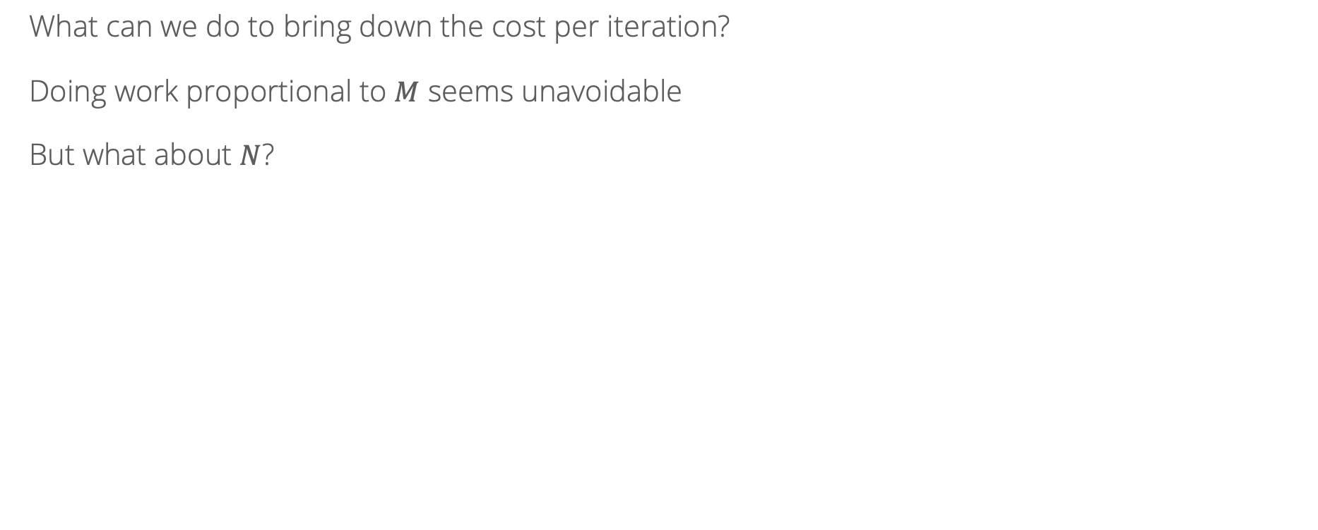
Cost per iteration
What can we do to bring down the cost per iteration?
Doing work proportional to $M$ seems unavoidable
But what about $N$?

Slide 13
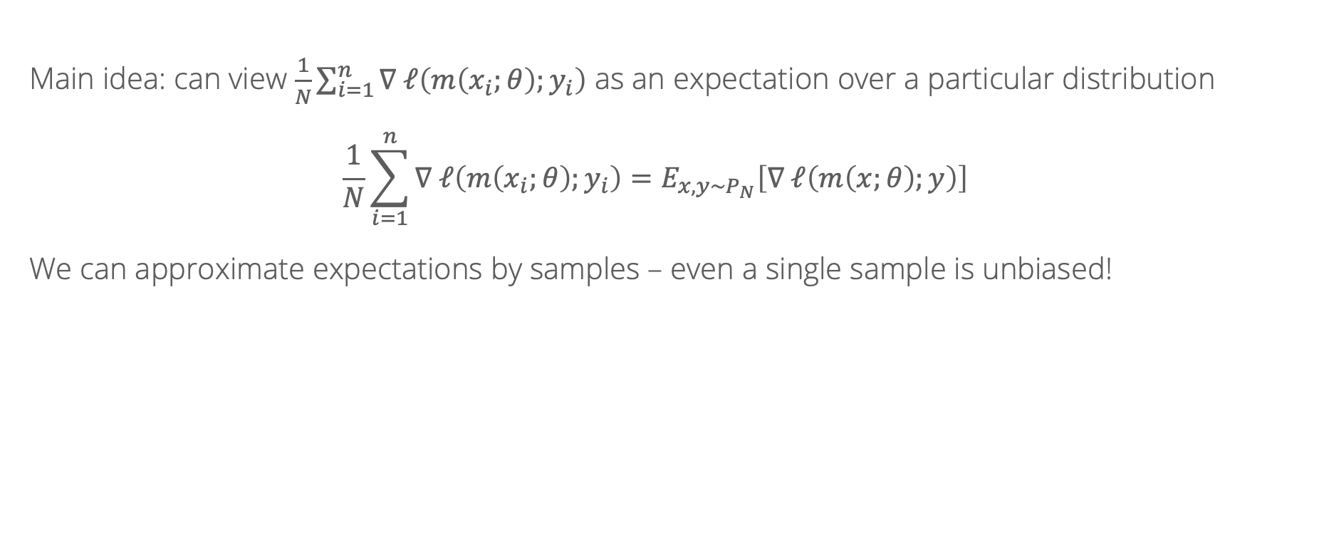
Stochastic gradient descent
Main idea: can view $\frac{1}{N}\sum_{i=1}^{n}{∇ ℓ\left(m\left(x_{i};θ\right);y_{i}\right)}$ as an expectation over a particular distribution
$$\frac{1}{N}\sum_{i=1}^{n}{∇ ℓ\left(m\left(x_{i};θ\right);y_{i}\right)}=E_{x, y∼P_{N}}\left[∇ ℓ\left(m\left(x;θ\right);y\right)\right]$$
We can approximate expectations by samples – even a single sample is unbiased!

Slide 14
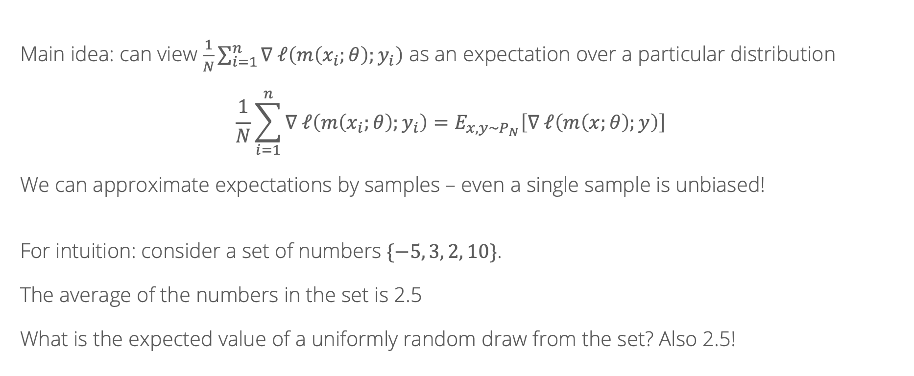
Stochastic gradient descent
Main idea: can view $\frac{1}{N}\sum_{i=1}^{n}{∇ ℓ\left(m\left(x_{i};θ\right);y_{i}\right)}$ as an expectation over a particular distribution
$$\frac{1}{N}\sum_{i=1}^{n}{∇ ℓ\left(m\left(x_{i};θ\right);y_{i}\right)}=E_{x, y∼P_{N}}\left[∇ ℓ\left(m\left(x;θ\right);y\right)\right]$$
We can approximate expectations by samples – even a single sample is unbiased!
For intuition: consider a set of numbers $\{−5, 3, 2, 10\}$.
The average of the numbers in the set is 2.5
What is the expected value of a uniformly random draw from the set? Also 2.5!

Slide 15
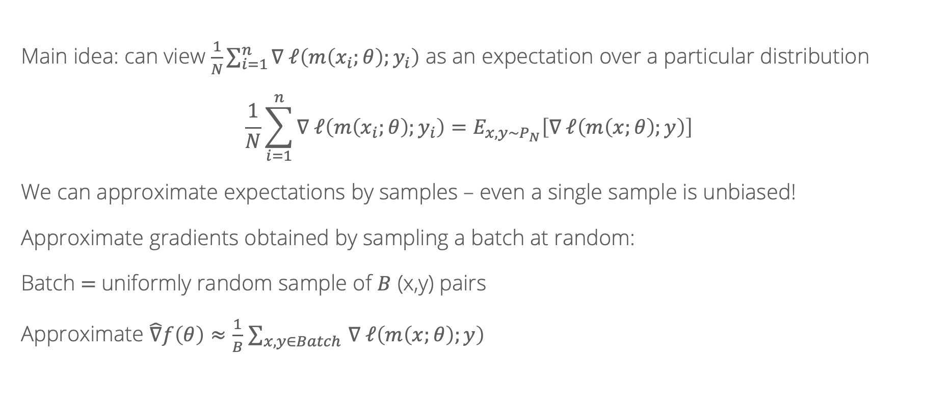
Stochastic gradient descent
Main idea: can view $\frac{1}{N}\sum_{i=1}^{n}{∇ ℓ\left(m\left(x_{i};θ\right);y_{i}\right)}$ as an expectation over a particular distribution
$$\frac{1}{N}\sum_{i=1}^{n}{∇ ℓ\left(m\left(x_{i};θ\right);y_{i}\right)}=E_{x, y∼P_{N}}\left[∇ ℓ\left(m\left(x;θ\right);y\right)\right]$$
We can approximate expectations by samples – even a single sample is unbiased!
Approximate gradients obtained by sampling a batch at random:
Batch $=$uniformly random sample of $B$ (x,y) pairs
Approximate $\hat{∇}f\left(θ\right)≈\frac{1}{B}$ $\sum_{x, y∈Batch }{∇ ℓ\left(m\left(x;θ\right);y\right)}$

Slide 16
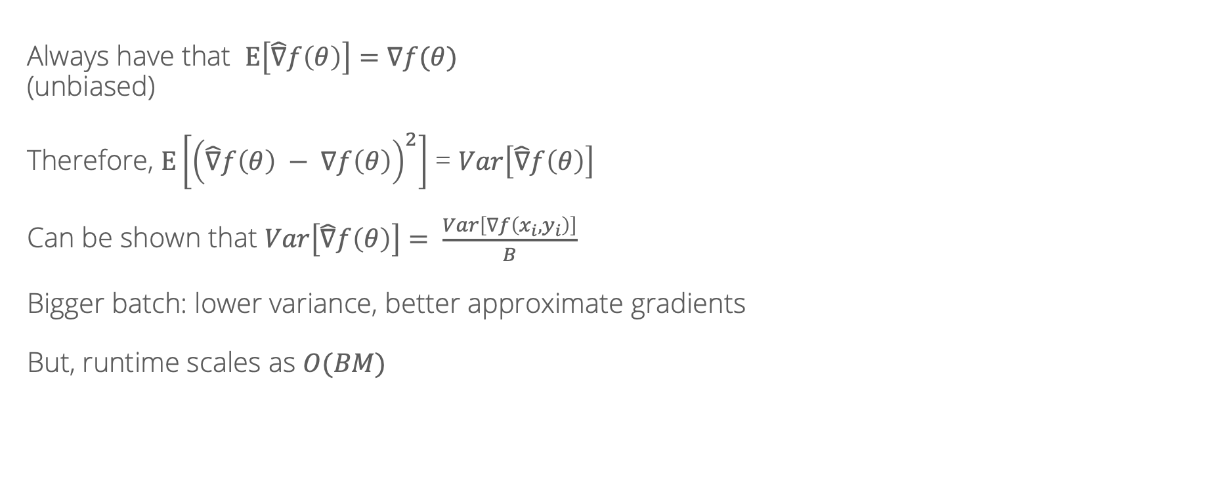
Stochastic gradient descent
Always have that $E\left[\hat{∇}f\left(θ\right)\right]=∇f(θ)$
(unbiased)
Therefore, $E\left[{\left(\hat{∇}f\left(θ\right) − ∇f\left(θ\right)\right)}^{2}\right]$ = $Var\left[\hat{∇}f\left(θ\right)\right]$
Can be shown that $Var\left[\hat{∇}f\left(θ\right)\right]= \frac{Var\left[∇f\left(x_{i}, y_{i}\right)\right]}{B}$
Bigger batch: lower variance, better approximate gradients
But, runtime scales as $O(BM)$

Slide 17
Number of iterations
What can we do to make the number of iterations better?
Where does gradient descent sometimes waste effort?
(Notebook)

Slide 18
Hard cases for gradient descent: Local minima
Local minimum
Local minimum
Global minimum

Slide 19
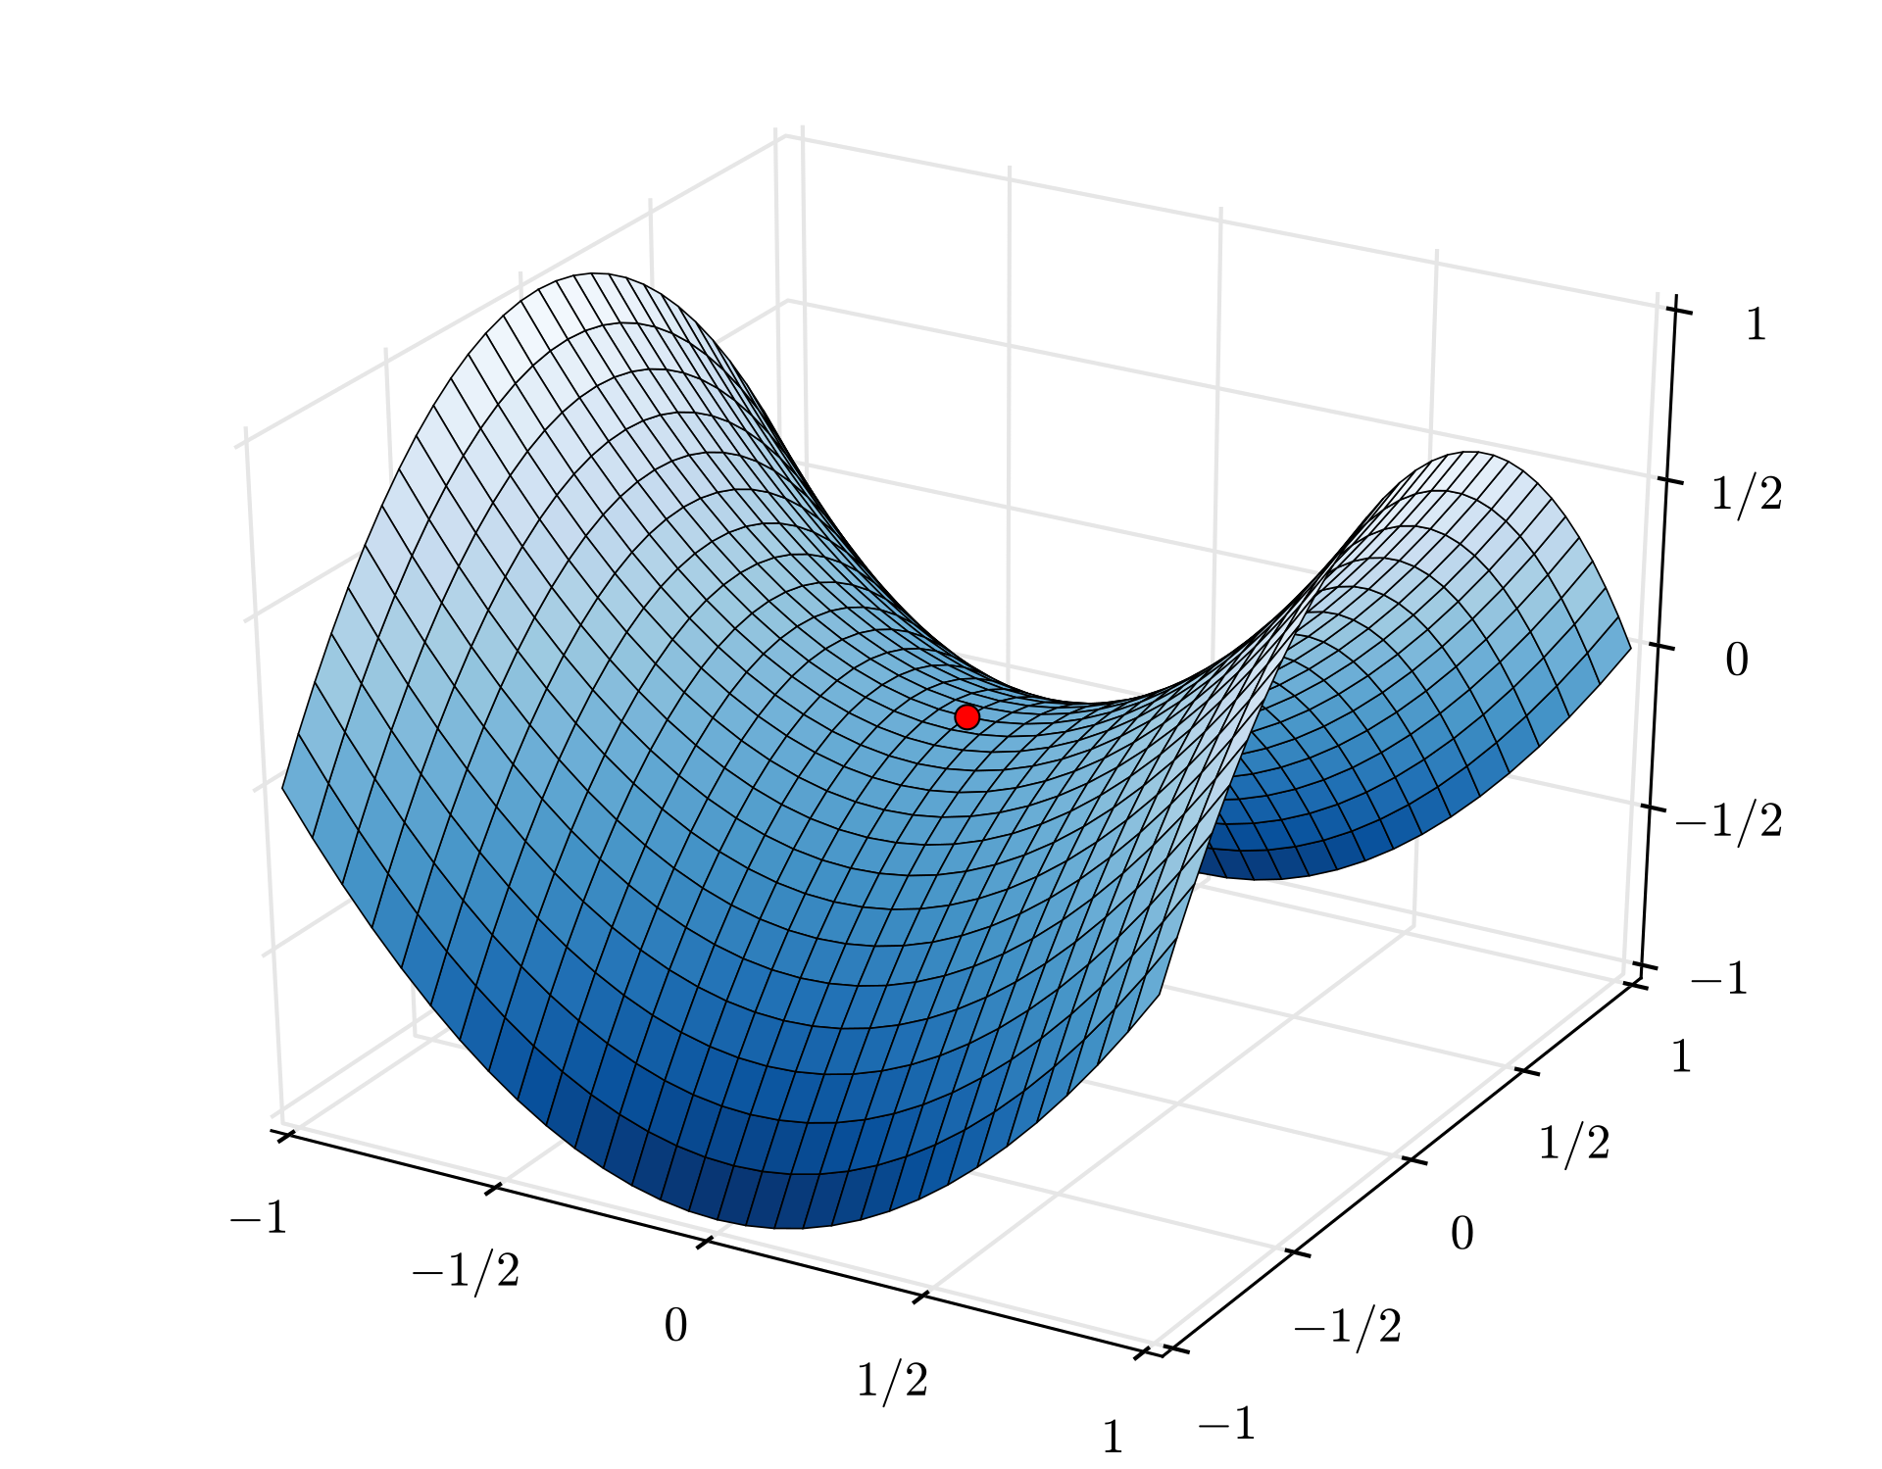
Hard cases for gradient descent: saddle points
https://en.wikipedia.org/wiki/Saddle_point

Slide 20
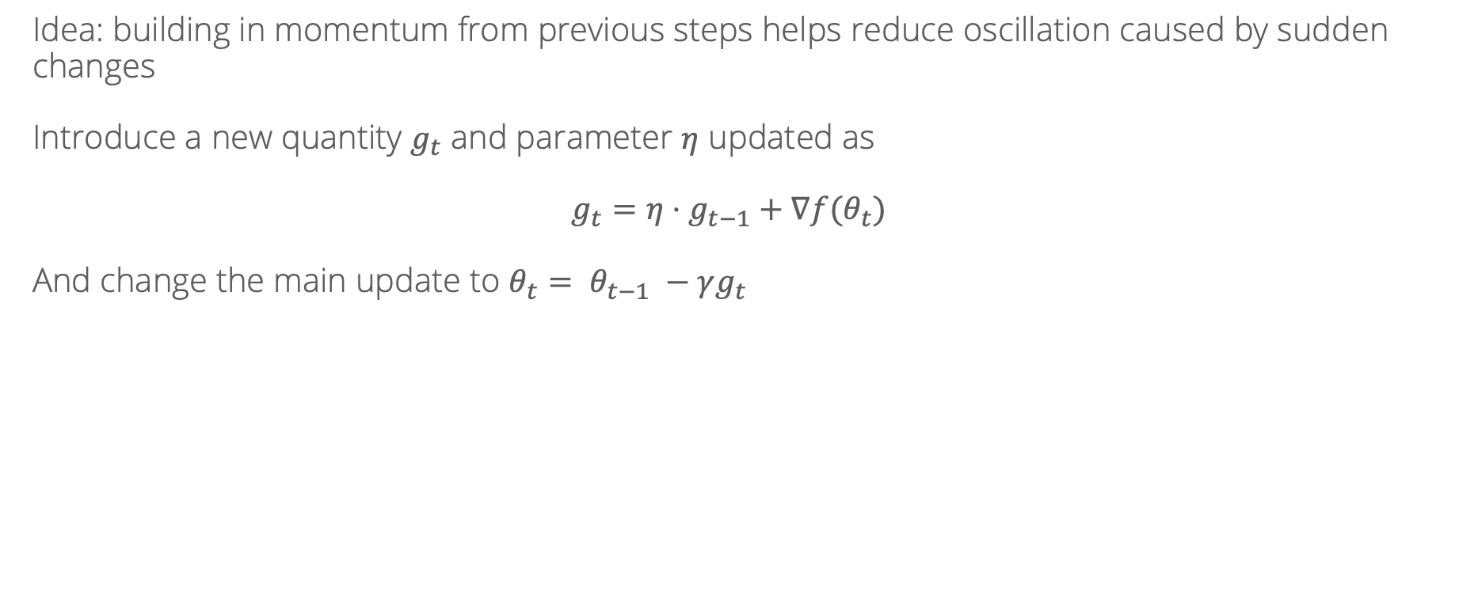
Momentum
Idea: building in momentum from previous steps helps reduce oscillation caused by sudden changes
Introduce a new quantity $g_{t}$ and parameter $η$ updated as
$$g_{t}={η⋅g}_{t−1}+∇f(θ_{t})$$
And change the main update to $θ_{t}= θ_{t−1} −γg_{t}$

Slide 21
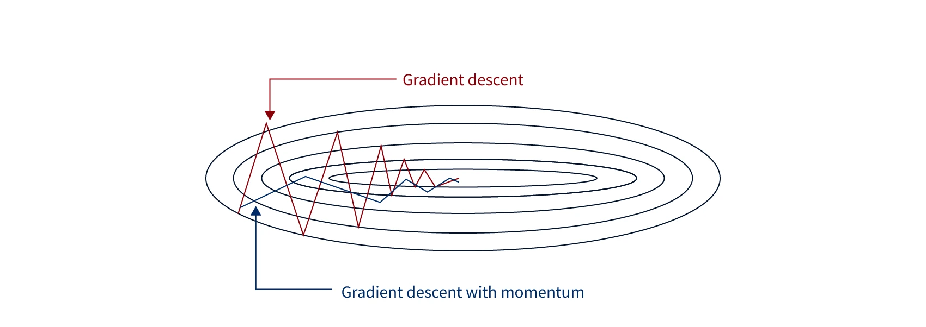
Image source: https://www.scaler.com/topics/momentum-based-gradient-descent/

Slide 22
Recall: Stochastic Gradient Descent w/ Momentum

Slide 23
Recall: Stochastic Gradient Descent w/ Momentum

Slide 24
Recall: Stochastic Gradient Descent w/ Momentum

Slide 25
Adaptive learning rates
Oftentimes, different parameters are “differently scaled”, making it hard to use a single learning rate/step size across all of them
We’d like to move fast in parameters with gentle but consistent gradients. When gradients are large and rapidly changing, move more slowly
Modern neural networks are usually trained with adaptive learning rate methods which change the learning rate for each parameter individually based on how large the gradients are

Slide 26
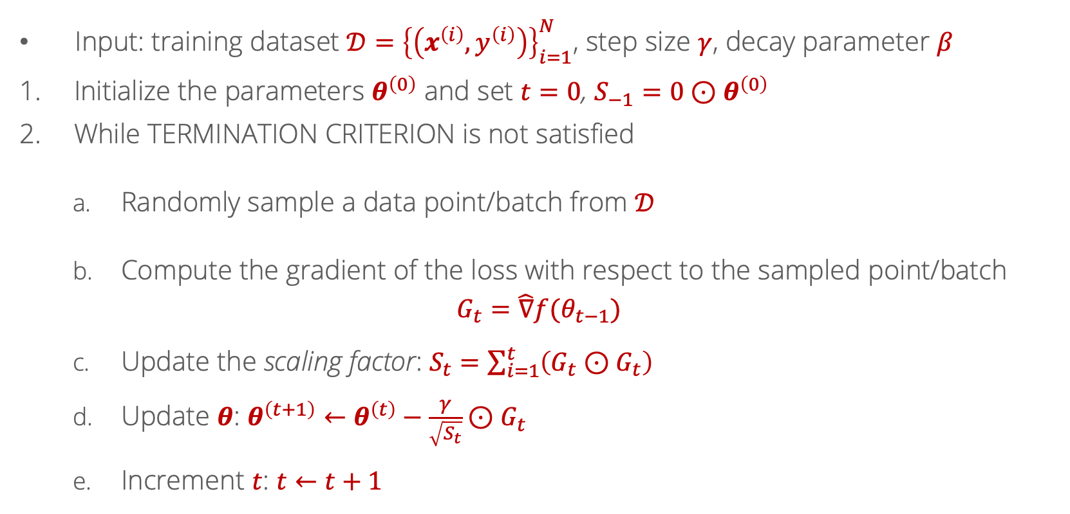
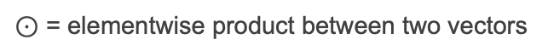
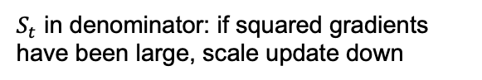
Adagrad
Input: training dataset $𝒟={\left\{\left(x^{\left(i\right)},y^{\left(i\right)}\right)\right\}}_{i=1}^{N}$, step size $γ$, decay parameter $β$
Initialize the parameters $θ^{\left(0\right)}$ and set $t=0$, $S_{−1}=0⊙θ^{\left(0\right)}$
While TERMINATION CRITERION is not satisfied
Randomly sample a data point/batch from $𝒟$
Compute the gradient of the loss with respect to the sampled point/batch
$$G_{t}=\hat{∇}f(θ_{t−1})$$
Update the scaling factor: $S_{t}=\sum_{i=1}^{t}{\left(G_{t}⊙G_{t}\right)}$
Update $θ$: $θ^{\left(t+1\right)}←θ^{\left(t\right)}−\frac{γ}{\sqrt{S_{t}}}⊙G_{t}$
Increment $t$: $t←t+1$
$⊙$ = elementwise product between two vectors
$S_{t}$ in denominator: if squared gradients have been large, scale update down

Slide 27
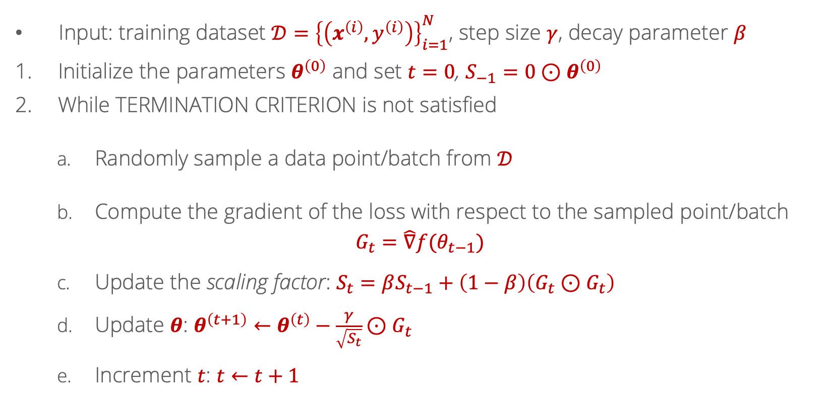
Root Mean Square Propagation (RMSProp)
Input: training dataset $𝒟={\left\{\left(x^{\left(i\right)},y^{\left(i\right)}\right)\right\}}_{i=1}^{N}$, step size $γ$, decay parameter $β$
Initialize the parameters $θ^{\left(0\right)}$ and set $t=0$, $S_{−1}=0⊙θ^{\left(0\right)}$
While TERMINATION CRITERION is not satisfied
Randomly sample a data point/batch from $𝒟$
Compute the gradient of the loss with respect to the sampled point/batch
$$G_{t}=\hat{∇}f(θ_{t−1})$$
Update the scaling factor: $S_{t}=βS_{t−1}+\left(1−β\right)\left(G_{t}⊙G_{t}\right)$
Update $θ$: $θ^{\left(t+1\right)}←θ^{\left(t\right)}−\frac{γ}{\sqrt{S_{t}}}⊙G_{t}$
Increment $t$: $t←t+1$
Moving average of squared gradients, instead of the sum: sum only gets bigger so the updates become small

Slide 28

Visualization
Source: https://imgur.com/a/Hqolp#2dKCQHh

Slide 29
Why not both?
Two techniques to improve performance: adaptive learning rates and momentum
Are these mutually exclusive? No!
The Adam optimizer combines RMSProp with momentum and is probably the most commonly used in practice

Slide 30
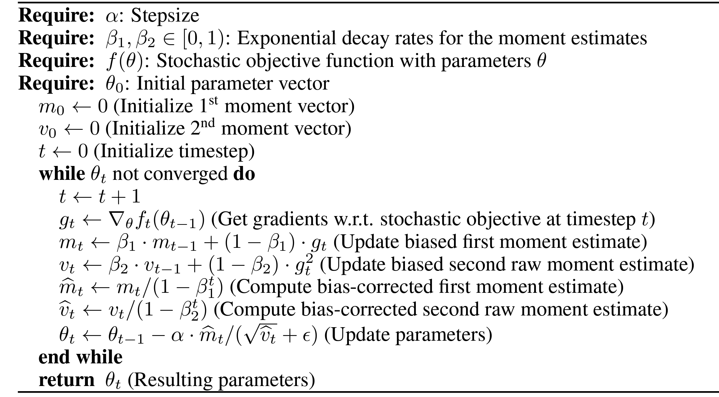
Adam

Slide 31
Search continued
So far, we’ve seen BFS/DFS, and then Dijkstra’s for computing shortest paths
Algorithms that we have are guaranteed to find the shortest path between two points eventually (BFS for unweighted graphs, Dijkstra’s for weighted)

Slide 32
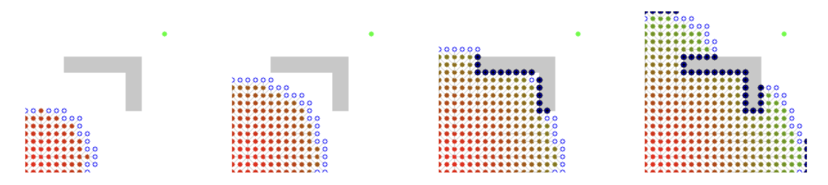
Example of Dijkstra’s algorithm
Notes:
def factorial(int n):
if ___________:
return ___________
return ___________________

Slide 33
When can we do better?
Dijkstra’s is an uninformed search algorithm: it makes no assumptions about the structure of the graph
An informed algorithm makes more assumptions, and does better if those assumptions are correct

Slide 34
Informed search with heuristics
Dijkstra’s explores nodes in order of their minimum distance so far
What if we add a heuristic which provides an estimate of the distance to the destination:
Common example of a heuristic on graphs representing locations: the straight-line distance
What could we do with a heuristic?

Slide 35
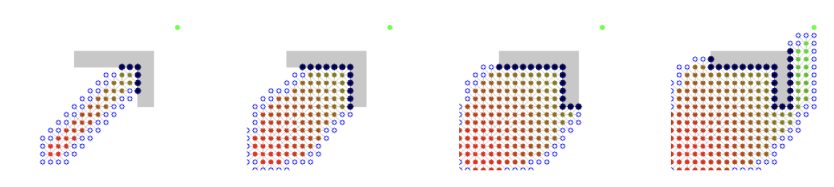
Greedy search
What if we just took the “best” node in every step?
Simply expanding the node with the best value of the heuristic
Doesn’t seem to work very well…

Slide 36
A* search
Combine Dijkstra’s algorithm with a heuristic
Track distances-so-far as in Dijkstra’s algorithm
Estimate distance to destination for a path going through node v:
Distance to get from source to v: dist[v]
Distance to get from v to destination: heuristic(v)
Final rule: explore the node with the minimum combined value of
dist[v] + heuristic(v)

Slide 37
Top: Dijkstra. Bottom: A*

Slide 38
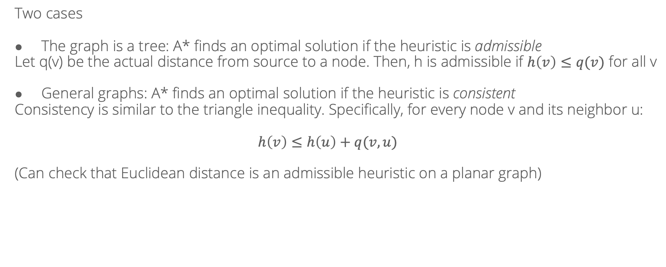
When does A* find an optimal solution?
Two cases
The graph is a tree: A* finds an optimal solution if the heuristic is admissible
Let q(v) be the actual distance from source to a node. Then, h is admissible if $h\left(v\right)≤q(v)$ for all v
General graphs: A* finds an optimal solution if the heuristic is consistent
Consistency is similar to the triangle inequality. Specifically, for every node v and its neighbor u:
$$h\left(v\right)≤h\left(u\right)+q(v, u)$$
(Can check that Euclidean distance is an admissible heuristic on a planar graph)

Slide 39
Search
So far: many search strategies (BFS, DFS, Dijkstra’s algorithm, A*)
In weighted graphs, Dijkstra’s will always find shortest paths
A* will do so with an admissible/consistent heuristic
Now: controllable tradeoff between computation and optimality

Slide 40
Beam search
Key idea: only process the most promising k nodes in each step; discard the others
“Promising” defined via a heuristic as in A*
Q = [source]
while Q is not empty:
new_Q = []
for node v in Q:
for u in neighbors(v):
if u == goal:
return
if not visited[u]:
visited[u] = True
new_Q.append(u)
Q = select_top_k(new_Q, heuristic)

Slide 41
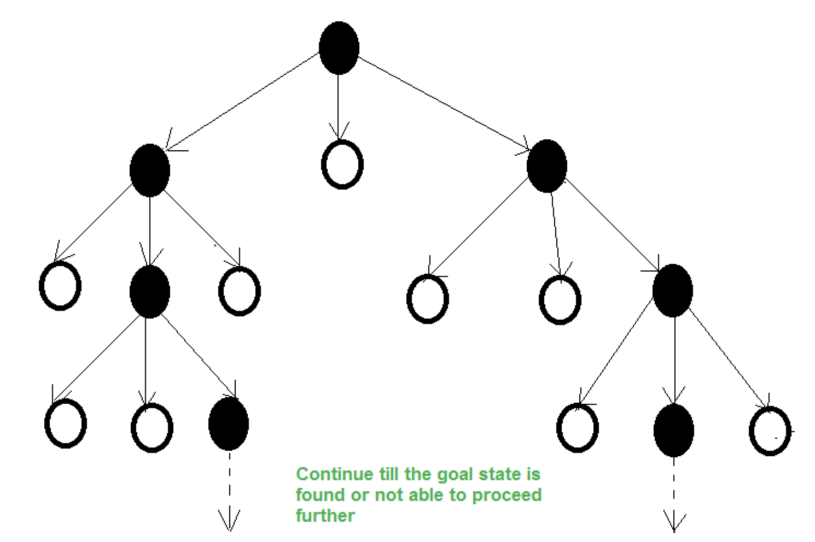

Slide 42
Beam search
Sacrifices worst-case optimality: the nodes on the optimal path might get pruned away due to the beam width limit
Improves memory usage
Works well if the heuristic is well-aligned with nodes that will actually appear on the optimal path

Slide 43
Beam search: applications
Commonly used in decoding step for language models
Model has a next-word probability distribution given previous words:
p(word 3 = ”chased”|word 1 = “the”, word 2 = “dog”)
In generation, the goal is to find the sequence with the largest overall probability

Slide 44
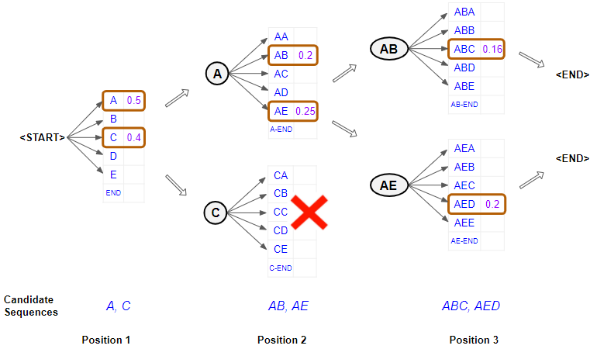
Beam search in language models
Heuristic = joint probability of sequence so far
Greedy search: choose the highest-probability token one at a time
Beam search: select the k best sequences to continue at each step

